Slide 1


Intercomprehension and Performativity
A Meschonnician Reading of Mediation
BÉATRICE COSTA & TRAUDL HEUPGEN
Politics of Intercomprehension
June 18, 2026

Slide 2



INTERCOMPREHENSION
MEDIATION
Establishing a parallel between the definition of intercomprehension as it is commonly understood in language didactics and the communicative processes at work in mediation.

Slide 3
INTERCOMPREHENSION AS A MODEL
In everyday interaction, intercomprehension frequently appears “natural,” almost self-evident. In situations of conflict, however, one suddenly perceives:
how fragile it is,
how relationally constructed it is,
how rhythmically sustained it is,
and how much it depends upon the work of a third party.

Slide 4
INTERCOMPREHENSION
MEDIATION
Not static, but processual.
It presupposes asymmetry and incompleteness.
It unfolds relationally.
It transforms subjects through interaction.
It involves a movement from receptivity toward agency.

Slide 5
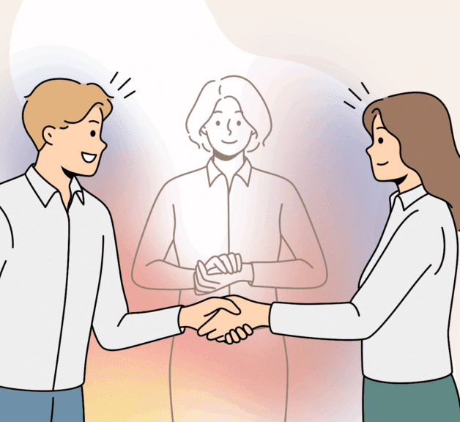
The mediator is not merely someone who “helps communication,” but someone who:
Sustains relational circulation,
Guarantees reciprocal addressability,
Redistributes listening,
And temporarily embodies the shared space that no longer exists between the parties themselves.

Slide 6
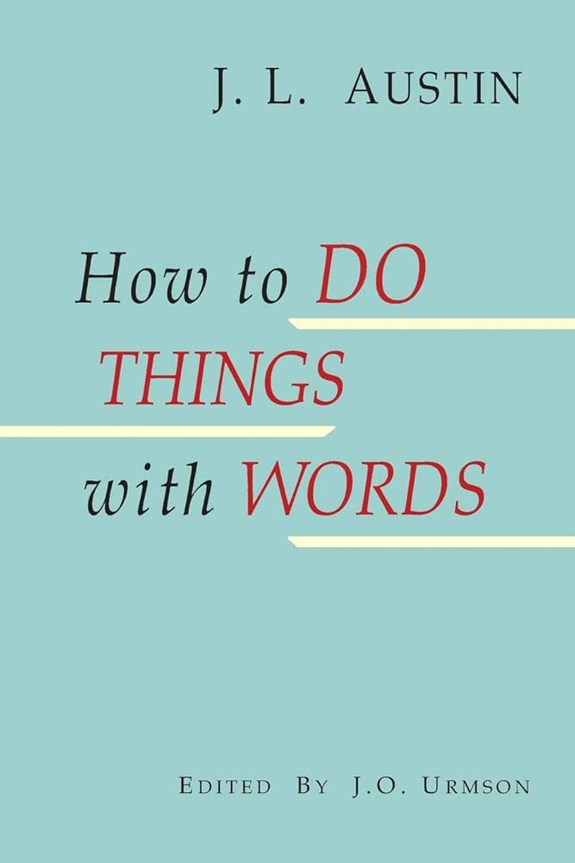

Effect of Language
Transformative Activity of Language Itself

Slide 7
Mediation as an operation of subjectivation
“Concernant le rapport entre dire et faire, contrairement à ce qui semble devenu la vulgate […] ce n’est pas ‘grâce à Austin qu’on le sait’, puisque, dès 1958, quatre ans avant Austin, Benveniste analysait et reconnaissait l’accomplissement par l’énonciation.”
(Meschonnic, Henri. “Seul comme Benveniste ou comment la critique manque de style.” In Langages, 29ᵉ année, n°118, 1995, pp. 31–55, here pp. 32–33. DOI: https://doi.org/10.3406/lgge.1995.1713)

Slide 8
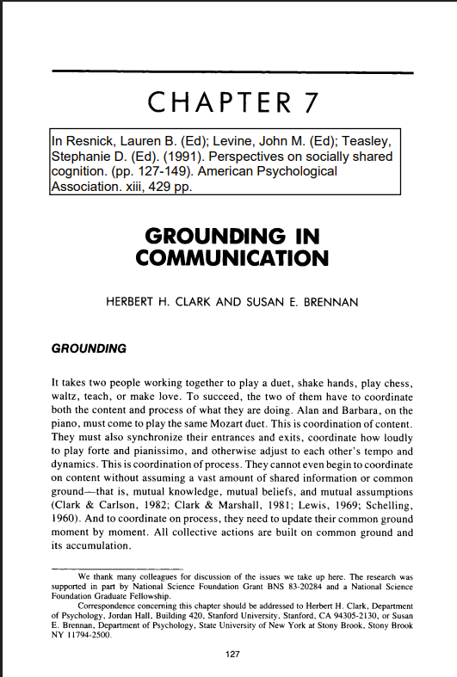
Shared Space
“It takes two people working together to play a duet, shake hands, play chess, waltz, teach, or make love. To succeed, the two of them have to coordinate both the content and process of what they are doing.”
(Clark, Herbert H.; Brennan, Susan E. “Grounding in Communication.” In Lauren B. Resnick, John M. Levine & Stephanie D. Teasley (eds.), Perspectives on Socially Shared Cognition. Washington, DC: American Psychological Association, 1991, pp. 127–149, here p. 127. DOI:10.1037/10096-006)

Slide 9

Against Dualistic Models of Discourse
Language
Verbal dimension
Content
Discourse
Gestures
Paralinguistic dimension
Affect
Body

Slide 10
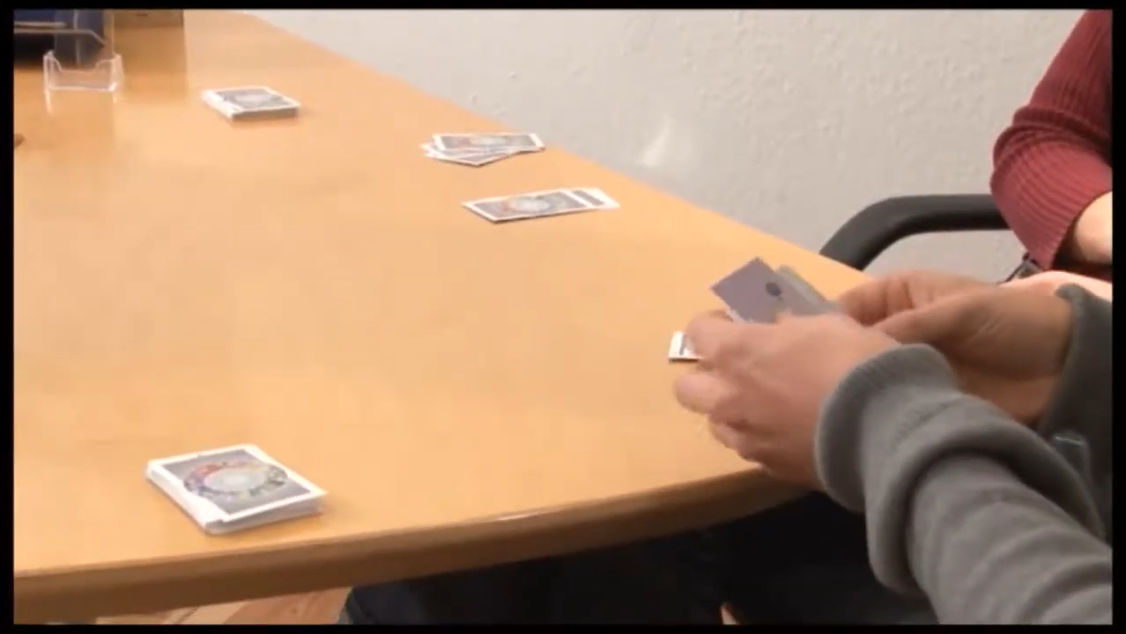
Opening Sequence of the Mediation Session

Slide 11
Parallel constructions and performativity
The repeated use of coordinated and parallel structures:
“so that I can understand what brings you here,”
“what your reasons are,”
“and then I will explain…”
inscribes the participants within a common discursive frame.

Slide 12

conclusion
The construction of relational space does not rely here upon explicit emotional markers or psychological interiority, but upon a syntax that articulates voices, distributes subject positions, and progressively opens a shared dialogical space.

Slide 13
MERCI POUR VOTRE ATTENTION !

